Slide 1
Team Status Report
Team Argus - 05/01/2015

Slide 2
Project Plan
Tracking through the end of the project
Cost Analysis
Planned Cost = 925 hours total (650 up to this point)
Actual Cost = 638 hours
Earned Value = 590 hours
CPI = .924 (Change from .988)
SPI = .907 (Change from .933)

Slide 3
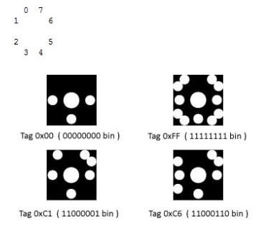
TagVisualizer with Transfer Layer
Send Stuff from PixelSense
Converted code from XNA(Game Engine) to WPF(Windows Form).
Can Flash Binary Characters now.
Tag Visualizer
First Step of Lynx Authentication
Can Flash relative to Visualized Tag.

Slide 4


Android Software
Complete in the sense anything can be sent
Still need to finalize what exactly are we sending

Slide 5
Android Software
Next
Game animations need to be optimized
Splash screen must be completed
Make it look more aesthetically nice (ie: image buttons, designer box and if time permits OpenGL graphics)

Slide 6
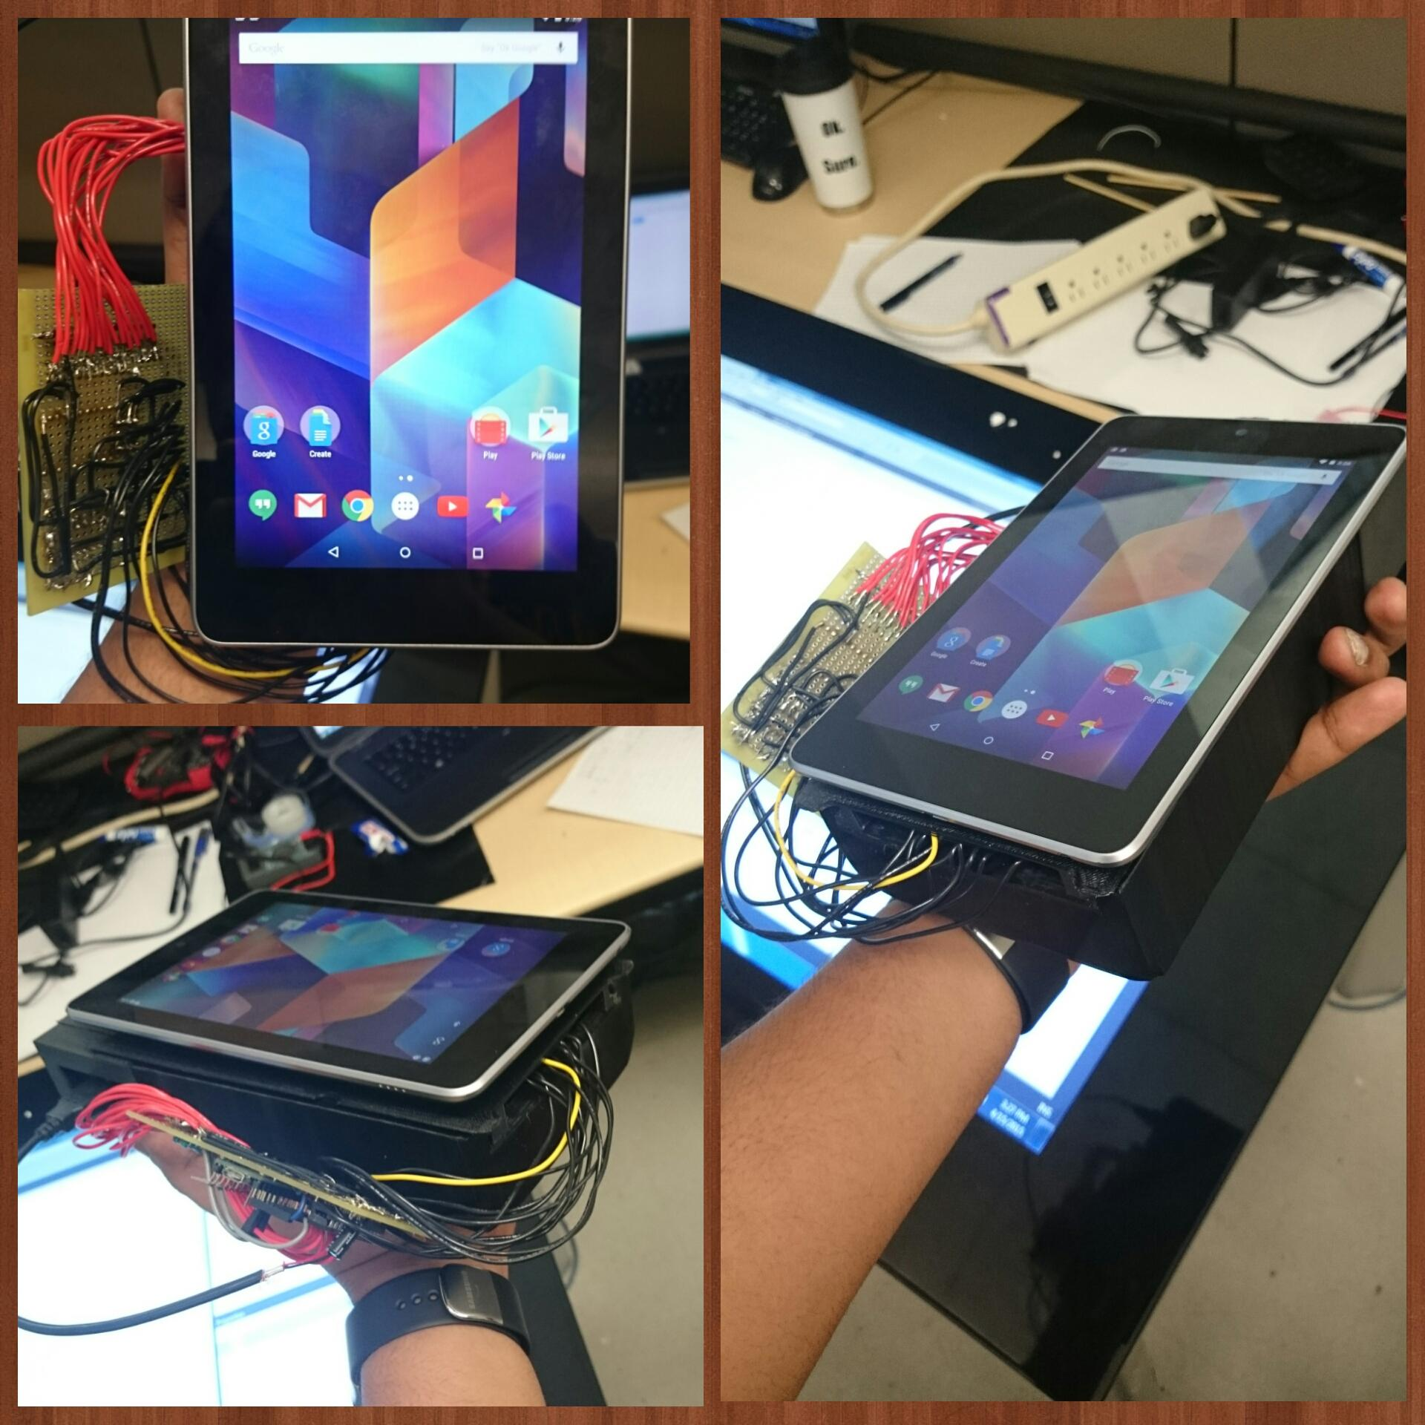
Hardware
Complete and functional
Possible bugs:
Pins malfunctioning
Battery pack is auto shutting off, so a load is required
Bad components

Slide 7
Reading Light
Configuring to the new hardware
Compensating for phototransistors being too close
Making adjustments for new WPF flashes
Future Tasks - Improve accuracy of light reading, implement handshake method of reading to properly sync reading and improve speeds

Slide 8
Transfer Layer Progress
Significant Setback - “New” Handshake bits
Tag Visualizer - SDK Treasure Hunt / XAML crash course
Future Tasks - Finalize Tag interface / begin work integrating with Lynx Transfer System

Slide 9
Blackjack Software
Developing in WPF instead of XNA
Transferring logic from old XNA to WPF
Currently:
Play game in console
Future:
integrate with GUI we have for Tag Visualizer

Slide 10
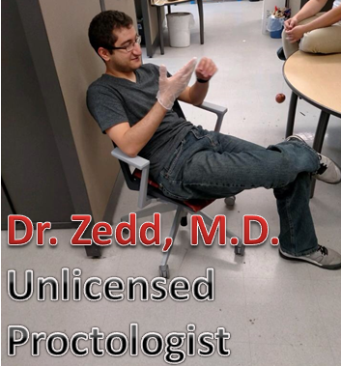
Risk Assessment
Risk | Severity | Probability | Setback | Containment
Hardware failures -Teensy -Nexus 7 -PixelSense -IR LEDs -Phototransistors | Very High | 35% | 1-4 weeks | Use hardware available to test and order new hardware for final product
Trouble integrating Blackjack software(XNA) with and TagVisualizer(WPF) | High | 70% | 1 week | Develop a new blackjack application using WPF (in progress)
Distractions in SD Lab | Moderate | 105% | 30 minutes | Headphones and loud music

Slide 11
Questions?
Fun Fact #88:
Vishal recently donated his “beard” to science...
...unfortunately they needed an actual beard
Notes:
:D

